Slide 1


Total Dissolved Gas simulation Case STudY
UNCLASSIFIED
Todd Steissberg
U.S. Army Engineer Research and Development Center, Environmental Laboratory
CE-QUAL-W2 Workshop, 2024
July 08 - 09, 2024
Environmental Systems
Modeling Team
UNCLASSIFIED

Slide 2
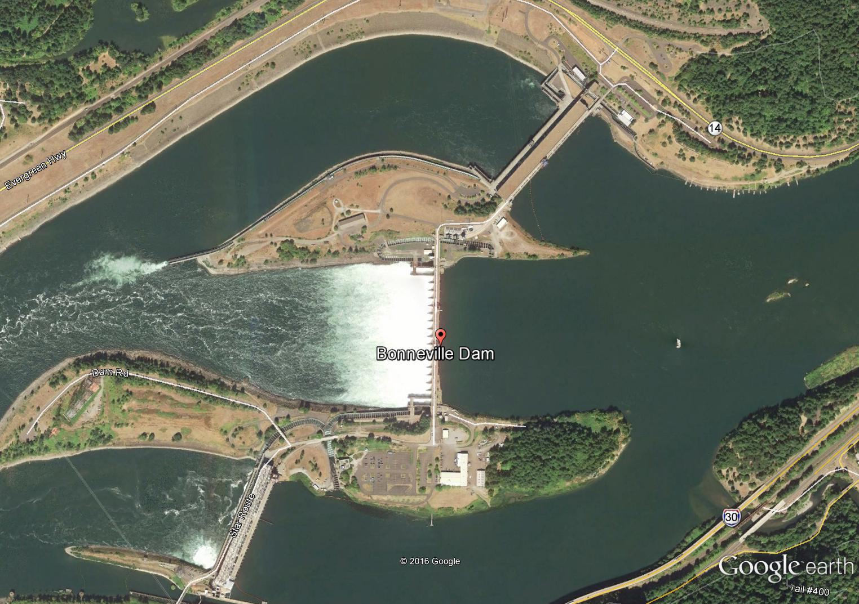
TDG Saturation
TDG refers to the total amount of dissolved gas present in water.
High TDG concentrations can cause gas bubble disease and reduce the population of some fish species.
Spillway operations result in atmospheric gases being forced into the water. The TDG concentrations below the dam are increased by spills, and TDG supersaturation occurs.
Notes:
TDG is the amount of gas present in water, mainly nitrogen and oxygen.

Slide 3
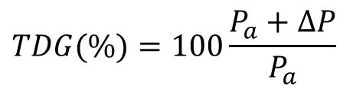
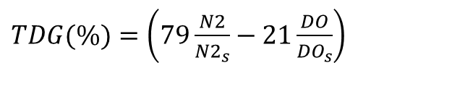
TDG Saturation
Calculating and reporting dissolved gas levels from water quality monitoring
1) Ratio of total dissolved gas pressure (TGP) to atmospheric pressure.
TDG = percent of total dissolved gas saturation (%),
P_{a} = local barometric pressure or atmospheric pressure (mmHg),
ΔP = gauge pressure (mmHg), which can be directly measured by several types of instruments.
$$TDG(\%)=100\frac{P_{a}+ΔP}{P_{a}}$$
2) Gas concentrations measured in mg/L
N2 = dissolved nitrogen gas (mg L⁻¹),
N2_{s} = nitrogen gas saturation (mg L⁻¹),
DO = dissolved oxygen [mg-O₂ L⁻¹],
DO_{s} = dissolved oxygen saturation [mg-O₂ L⁻¹].
$TDG(\%)=\left(79\frac{N2}{{N2}_{s}}−21\frac{DO}{{DO}_{s}}\right)$
Notes:
TDG is the amount of gas present in water, mainly nitrogen and oxygen.

Slide 4


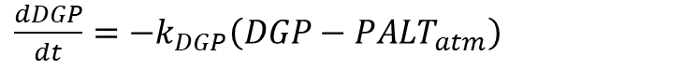
Overview of TDG Simulation in CE-QUAL-W2
TDG is computed as a derived variable
1) N2 + DO
2) DGP (Dissolved Gas Pressure)
Lake/reservoir Reaeration equations
$\frac{dN2}{dt}=−\frac{1}{h}k_{aN2}\left(N2−{N2}_{s}\right)$
k_{aN2} = nitrogen gas reaeration coefficient, m s⁻¹.
$\frac{dDGP}{dt}=−k_{DGP}\left(DGP−{PALT}_{atm}\right)$
$$k_{DGP}=max\left(k_{DGP}, MINKL\right)$$
It is assumed that wind is the dominant forcing function for reaeration.
k_{DGP}= air/water gas exchange rate, d⁻¹.

Slide 5
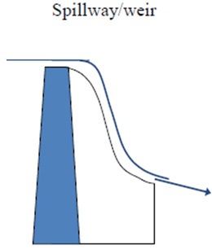
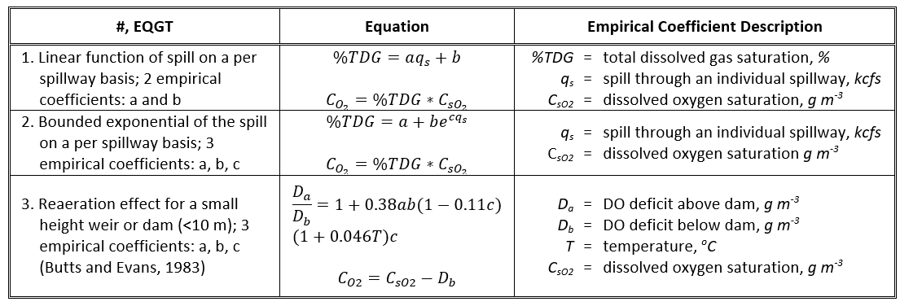
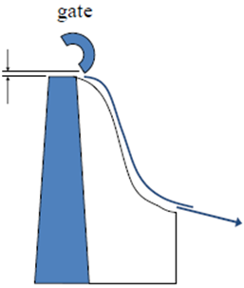
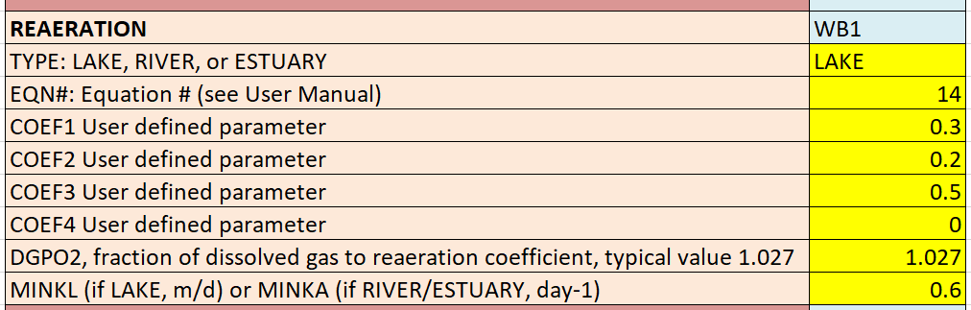
Reaeration Effects of Spillways, Weirs, and Gates

Slide 6
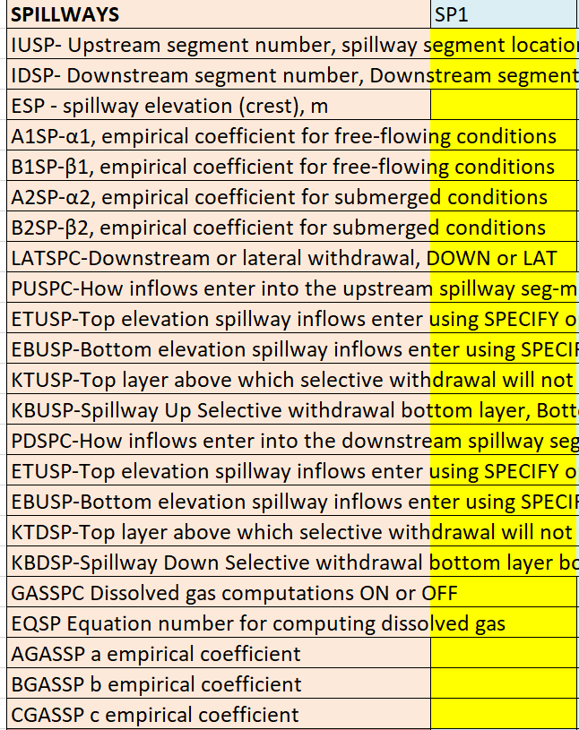
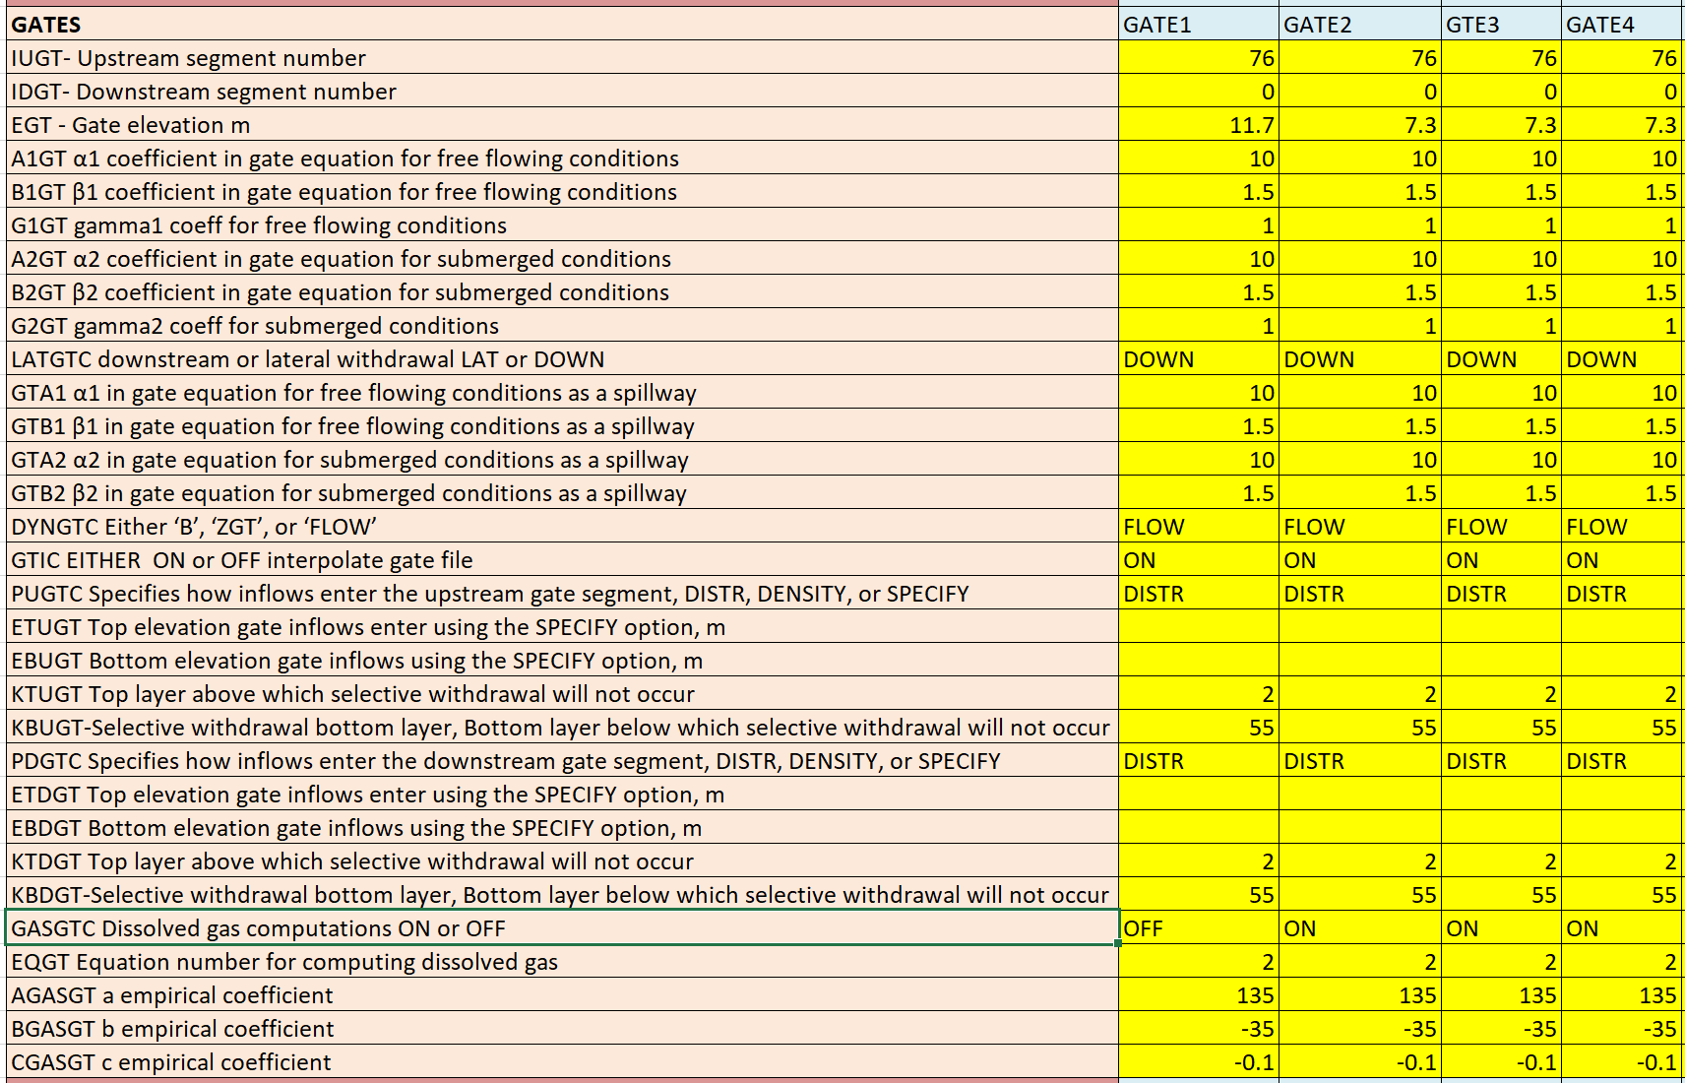
Total Dissolved Gas (TDG)

Slide 7
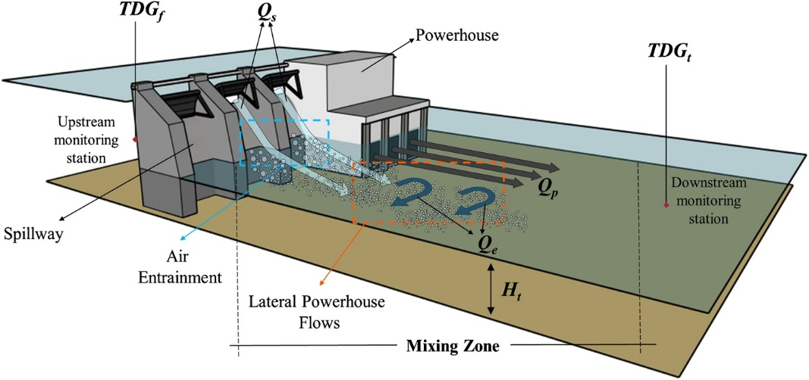
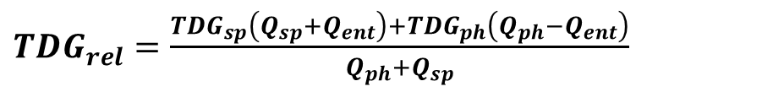
Reaeration Effects of Gates - SYSTDG
${TDG}_{rel}=\frac{{TDG}_{sp}\left(Q_{sp}+Q_{ent}\right)+{TDG}_{ph}\left(Q_{ph}−Q_{ent}\right)}{Q_{ph}+Q_{sp}}$
Qtot, Qspill, Qph, Qent
TDGspill is computed from spillway TDG production equation
TDGrel is computed as the flow weighted average value
Schneider, M., Hamilton, L., 2015. SYSTDG Developer’s Manual. U.S. Army Corps of Engineers, Northwestern Division, Reservoir Control Center.

Slide 8
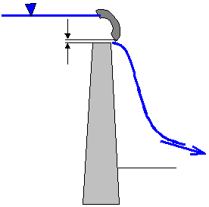
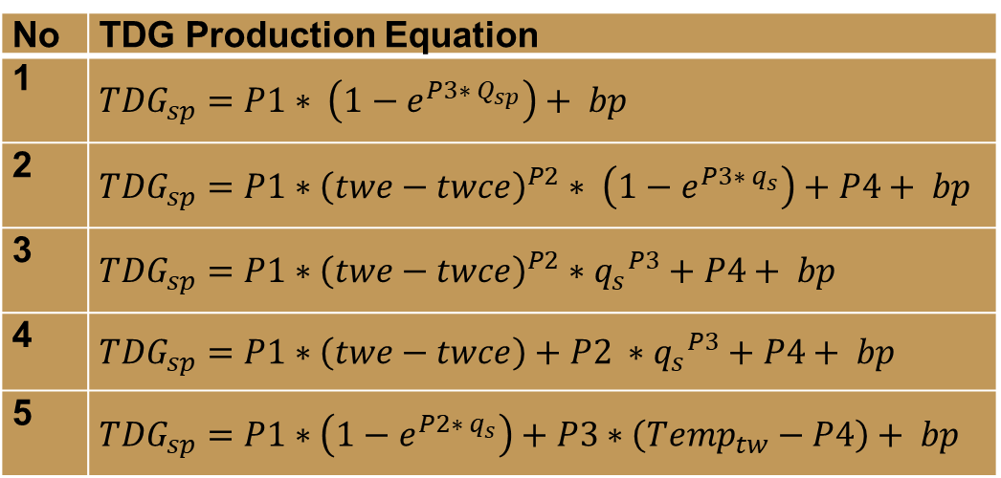
SYSTDG Algorithms
No | TDG Production Equation
1 | $${TDG}_{sp}=P1∗ \left(1−e^{P3∗ Q_{sp}}\right)+ bp$$
2 | ${TDG}_{sp}=P1∗{\left(twe−twce\right)}^{P2}∗ \left(1−e^{P3∗ q_{s}}\right)+P4+ bp$
3 | $${TDG}_{sp}=P1∗{\left(twe−twce\right)}^{P2}∗{q_{s}}^{P3}+P4+ bp$$
4 | $${TDG}_{sp}=P1∗\left(twe−twce\right)+P2 ∗{q_{s}}^{P3}+P4+ bp$$
5 | $${TDG}_{sp}=P1∗\left(1−e^{P2∗ q_{s}}\right)+P3∗\left({Temp}_{tw}−P4\right)+ bp$$
SYSTDG is an Excel-based spreadsheet model used to compute TDG saturation levels in reservoir and riverine systems.
No | Powerhouse Flow Entrainment Equation
1 | Q_{ent} = E1 * Q_{sp} + E2
2 | Q_{ent} = min[ (Q_{tot} / 60) , 1] * E1 * Q_{sp} + E2
3 | Q_{ent} = min[ (Q_{sp} / 20) , 1] * E1 * Q_{sp} + E2

Slide 9
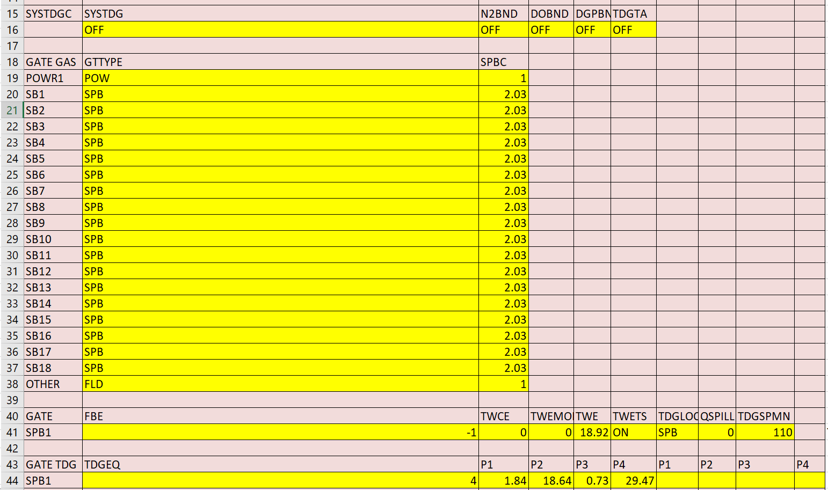
System Total Dissolved Gas (SYSTDG) Control File

Slide 10
Bonneville Dam
Bonneville Dam is located on Columbia River Mile (RM) 146.1 and is a run-of-river dam.
The reservoir is 48 miles long, from Bonneville Dam to the foot of Dalles Dam upstream, with a surface area of 29.5 square miles, and a capacity of 537,000 acre-feet.
The full forebay elevation is 77 feet, and the maximum forebay elevation is 82.5 feet.
The Dam is 171 feet high and 2,477 feet long.
The spillway is 1,070 feet long and contains 18 spill bays each with a 50 feet by 60 feet lift gate.
Bonneville Dam is equipped with 2 powerhouse units, 18 spillbays, and 1 fish ladder.
Columbia River System Operations Final Environmental Impact Statement:
https://www.nwd.usace.army.mil/CRSO/Final-EIS/
Notes:
TDG supersaturation in waters has been identified as one of the possible negative environmental effects of dams

Slide 11
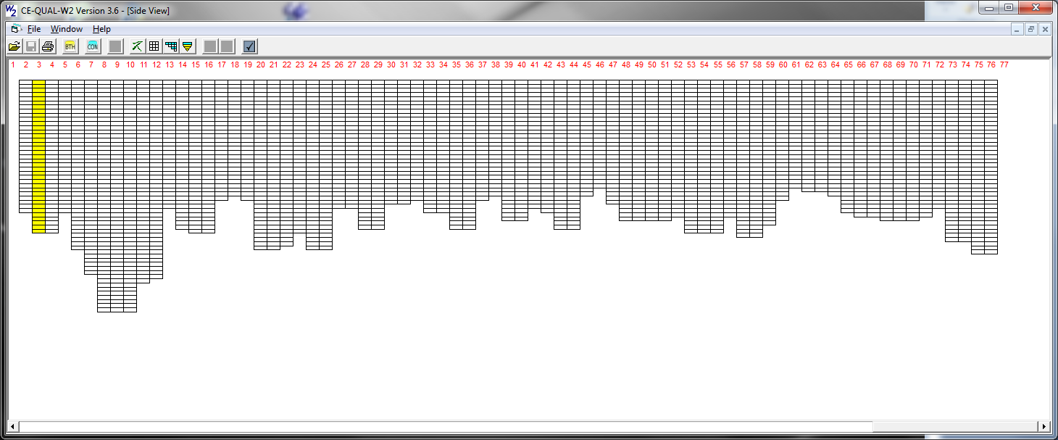
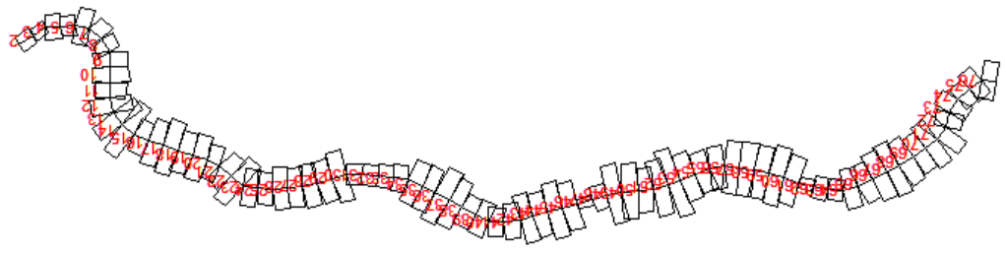
Bonneville Dam W2 Model
File type |  | File name
Wind sheltering | WSC FILE WSCFN | BON_WSC.npt
Shading | SHDFN | BON_SHD_1.npt
Bathymetry | BTHFN | BON_NAVD88_BTH_2011.csv
Meteorological | METFN | BON_2011_2015_MET.csv
Branch inflow | QINFN branch inflow | DALLES_OUTFLOW.csv
 | TINFN branch temp | two_41_TDA.opt
 | CINFN branch conc | cwo_41_TDA.opt
 | QDTFN Distributed flow | BON_DistributedTribInflow.npt
 | TDTFN Distributed temp | two_41_TDA.opt
 | CDTFN Distributed conc | cwo_41_TDA.opt
Spillway/Gate | QGTFN | QGT_BON_2011_2015.csv

Slide 12
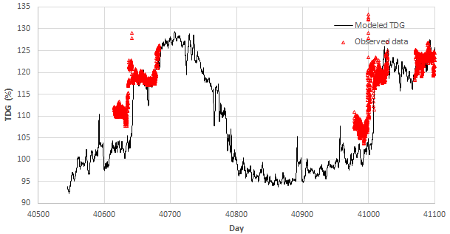
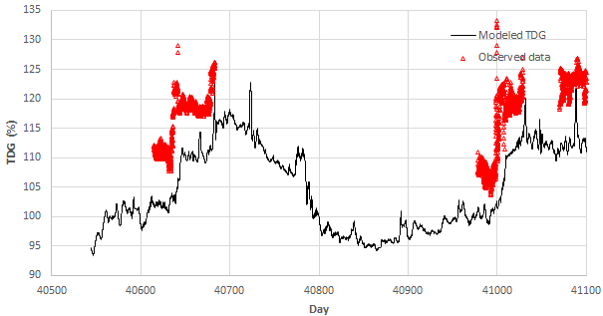
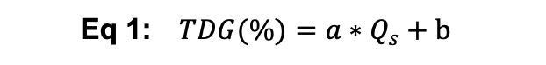

W2 Modeled TDG Results with N2+DO
SYSTDG = ON
SYSTDG = OFF
Eq 4:
$${TDG}_{sp}=P1∗\left(twe−twce\right)+P2 ∗{q_{s}}^{P3}+P4+ bp$$
Eq 1: $TDG(\%)=a∗Q_{s}+b$
P1 = 1.84, P2 = 18.64, P3 = 0.73, P4 = 29.47
a = 0.12, b = 105.61
Q_{ent} = E1 * Q_{sp} + E2
E1 = 0, E2 = 0

Slide 13
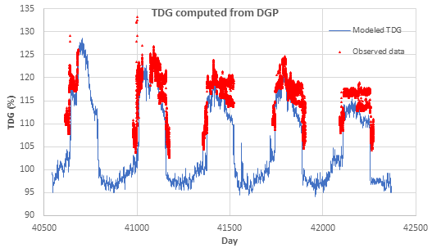

W2 Modeled TDG Results With DGP
SYSTDG = ON
Eq 4:
$${TDG}_{sp}=P1∗\left(twe−twce\right)+P2 ∗{q_{s}}^{P3}+P4+ bp$$
Q_{ent} = E1 * Q_{sp} + E2
P1 = 1.84, P2 = 18.64, P3 = 0.73, P4 = 29.47
E1 = 0, E2 = 0

Slide 14
Hands-On Exercises
Review model input files from “Bonneville W2 Project”
Run the W2 model and review the model outputs of withdrawal TDG in dwo_76.csv
Change SYSTDG parameters and rerun the model and see the difference of TDG in dwo_76.csv
P1, P2, P3, P4
E1, E2

Slide 15

Questions?

